Slide 1
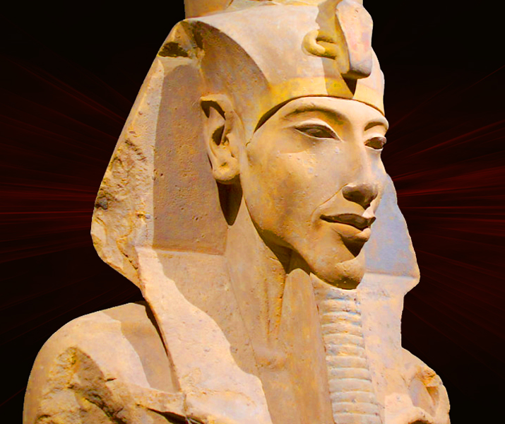
Path to Power
GOAL/S: Outline Amenhotep’s Path to Power
Week 10, Lesson 1

Slide 2
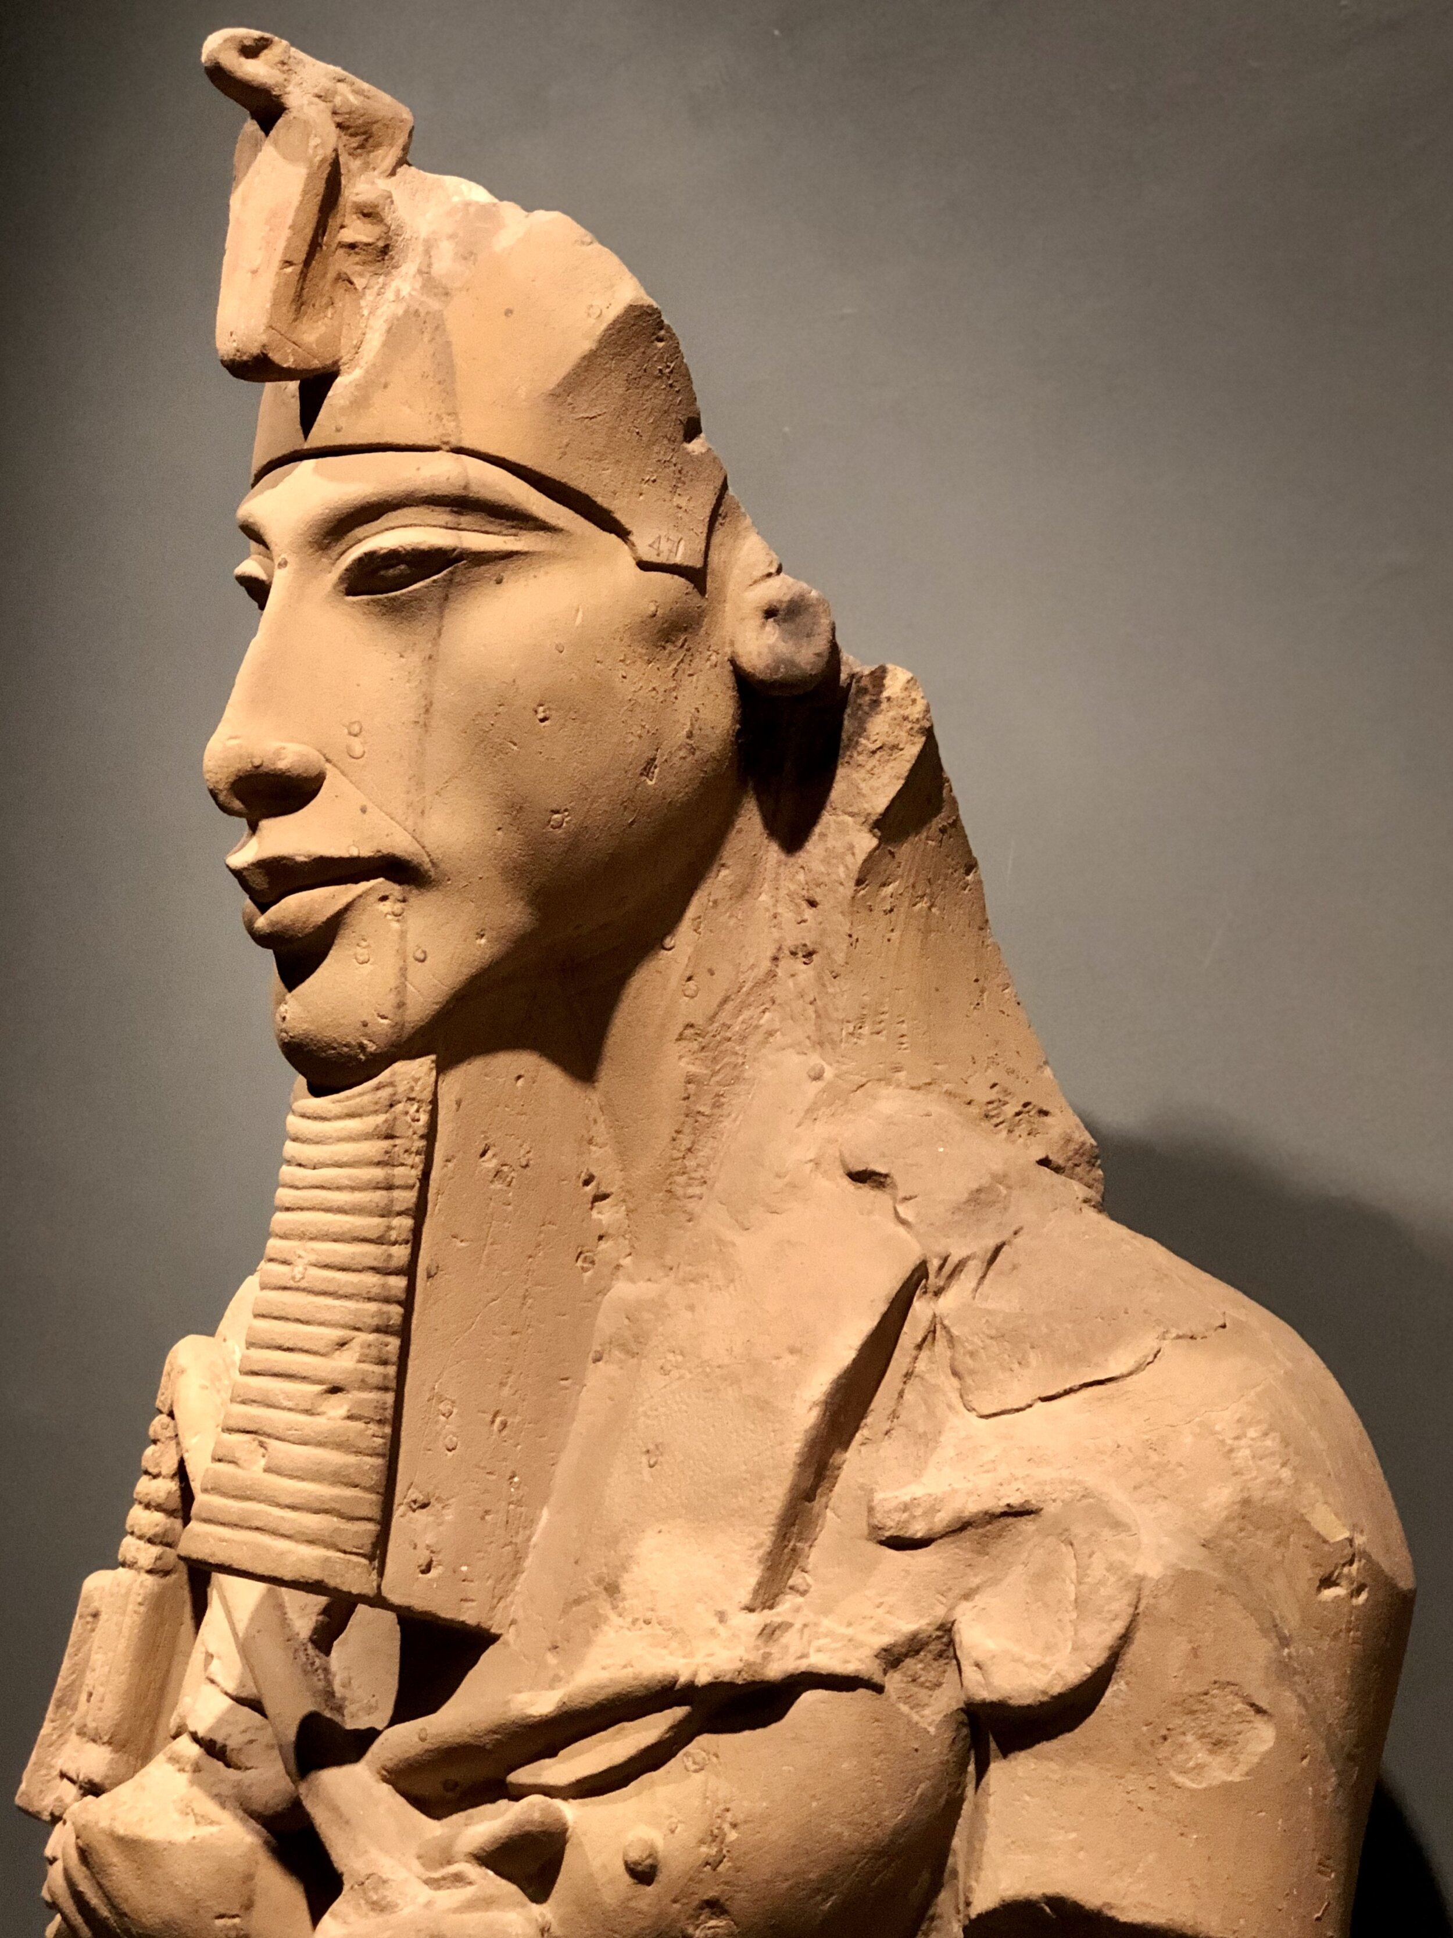
Akhenaten was a pharaoh who ruled over Egypt during the 18th Dynasty and sparked one of history's most fascinating religious revolutions. He ascended the throne amidst Egypt's golden age, but triggered a period of turmoil in Egypt's religious traditions by promoting the worship of Aten, the sun disk. In his fifth year of rule, he abandoned traditional gods, built a new capital city, and even radical transforming Egyptian society. But such dramatic changes in such a short time would lead to the destruction of his dreams very soon after his death.

Slide 3
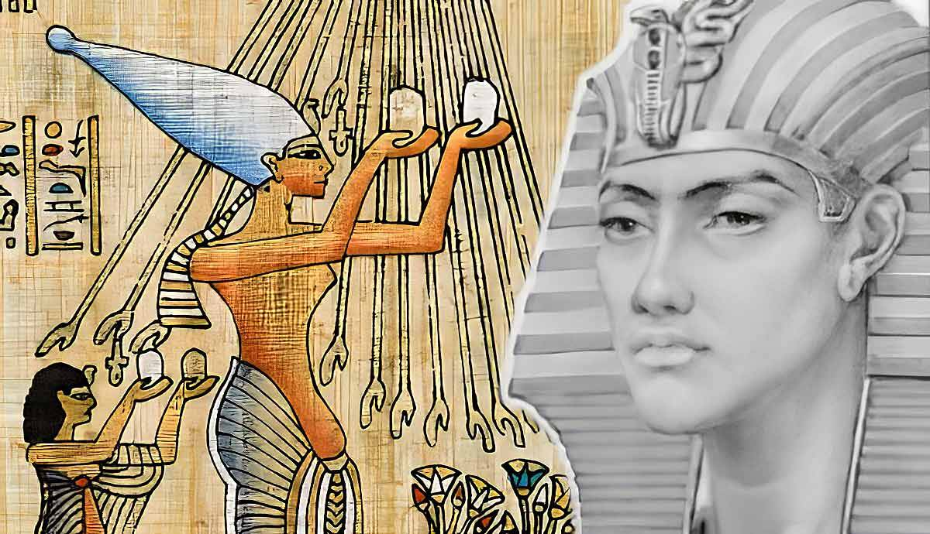
The ‘Heretic’ King
KEY TERM
DEFINITION:
someone whose beliefs or actions are considered wrong by most people, because they disagree with beliefs that are generally accepted
Akhenaten is sometimes referred to as the ‘Heretic King’

Slide 4
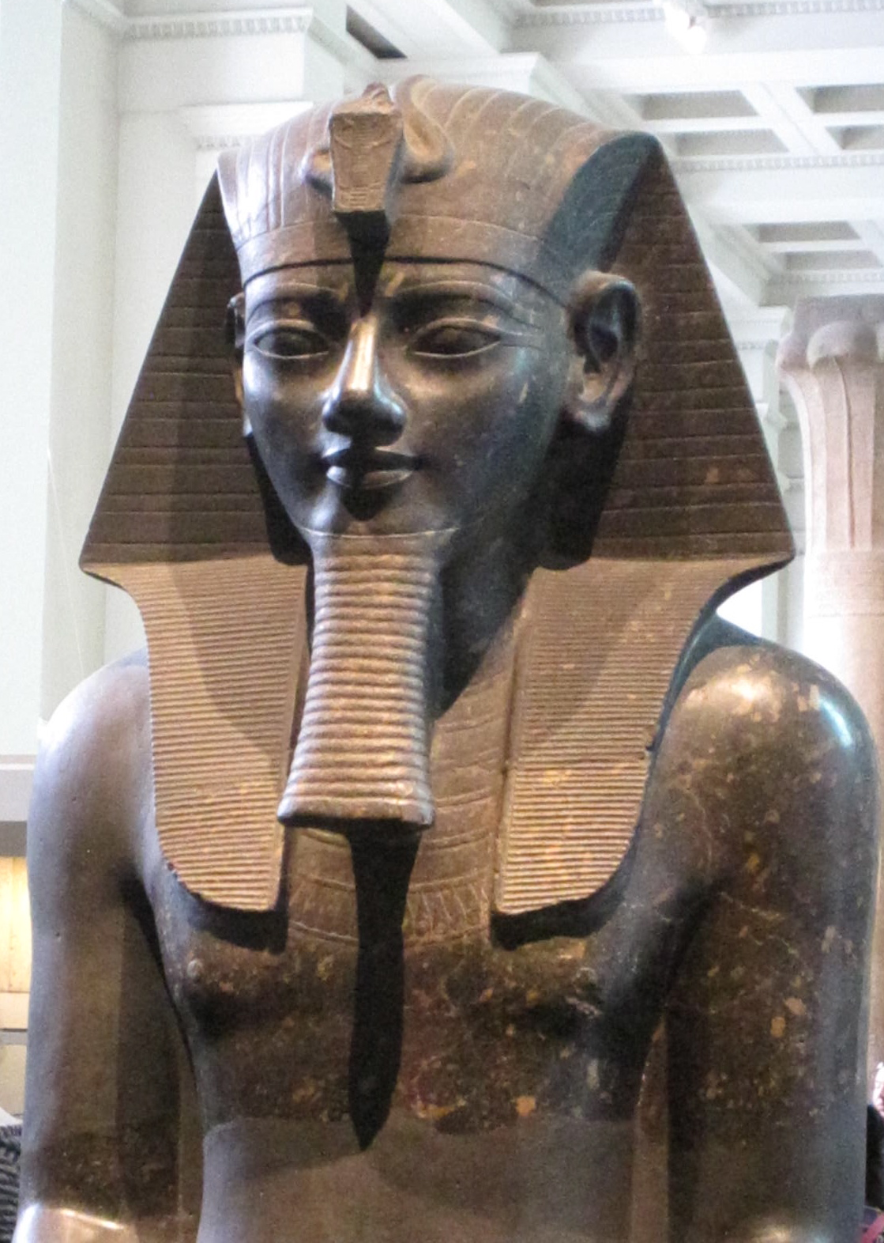
Co-Regent
KEY TERM
DEFINITION:
Joint ruler/co-ruler
Amenhotep IV may have ruled as co-regent with his father for some years.
Notes:
PICTURE: Amenhotep III

Slide 5
Early Life
Born c.1370 BCE as Amenhotep IV.
Son of Pharaoh Amenhotep III and Queen Tiye.
Upbringing is not well-documented.
Likely educated in religious texts and literature, common in the royal household.
Likely received military training, as was customary for royal princes.
He was about 16 or 17 years old when he became pharaoh.

Slide 6
Early Life
Egypt was the richest and most powerful kingdom during his childhood.
The god Amun was the primary deity, and the priests of Amun were very powerful.
Priests of Amun had riches and political influence rivaling the pharaohs.
This co-regency would have helped him learn about governing.
Amenhotep IV became pharaoh around 1351 BCE after Amenhotep III's unexpected death.

Slide 7
Pathway to Power
Amenhotep III’s Death (around 1353 BCE) marked the end of a prosperous and stable reign.
The transition brought uncertainty and expectations for the new ruler.
Initially known as Amenhotep IV, who later changed his name to Akhenaten.
Succession or Co-regency?
Some historians believe Amenhotep IV ruled alongside his father for a period.
Queen Tiye, Amenhotep III's influential wife, played a crucial role in ensuring a smooth succession.
Reliefs, inscriptions, and artifacts hint at a possible co-regency.

Slide 8
ACTIVITY – Steps to Power (Diagram)
Draw the flow chart and fill in using the following slides

Slide 9
Legitimate Claim: Amenhotep IV’s claim to the throne was based on his direct lineage as the son of Amenhotep III and Queen Tiye, both highly respected figures.

Slide 10
Legitimate Claim: Amenhotep IV’s claim to the throne was based on his direct lineage as the son of Amenhotep III and Queen Tiye, both highly respected figures.
Political Context: The transition of power involved complex political manoeuvring, including potential co-regency, alliances through marriage, and navigating the influence of powerful religious figures.

Slide 11
Legitimate Claim: Amenhotep IV’s claim to the throne was based on his direct lineage as the son of Amenhotep III and Queen Tiye, both highly respected figures.
Political Context: The transition of power involved complex political manoeuvring, including potential co-regency, alliances through marriage, and navigating the influence of powerful religious figures.
Religious Dynamics: The powerful Amun priesthood played a crucial role in maintaining religious harmony, which was essential for the new pharaoh to secure his position.

Slide 12
Legitimate Claim: Amenhotep IV’s claim to the throne was based on his direct lineage as the son of Amenhotep III and Queen Tiye, both highly respected figures.
Political Context: The transition of power involved complex political maneuvering, including potential co-regency, alliances through marriage, and navigating the influence of powerful religious figures.
Religious Dynamics: The powerful Amun priesthood played a crucial role in maintaining religious harmony, which was essential for the new pharaoh to secure his position.
Support Networks: Strategic alliances with key officials and priests were critical for ensuring political stability and consolidating power during the early years of Amenhotep IV’s reign.

Slide 13
Legitimate Claim: Amenhotep IV’s claim to the throne was based on his direct lineage as the son of Amenhotep III and Queen Tiye, both highly respected figures.
Political Context: The transition of power involved complex political manoeuvring, including potential co-regency, alliances through marriage, and navigating the influence of powerful religious figures.
Religious Dynamics: The powerful Amun priesthood played a crucial role in maintaining religious harmony, which was essential for the new pharaoh to secure his position.
Support Networks: Strategic alliances with key officials and priests were critical for ensuring political stability and consolidating power during the early years of Amenhotep IV’s reign.

Slide 14

ACTIVITY – Influential Figures
Get ONE (1) information sheet between 2
Read through the information sheet ‘Influential Figures’
Summarise in dot-points using the table provided
Cut and glue table in your book/put it in your folder
Return info sheet to Ms Barrie

